Slide 1
CHAPTER 3
THE MANAGER’S WORK ENVIRONMENT AND ETHICAL RESPONSIBILITIES
Doing the Right Thing

Slide 2
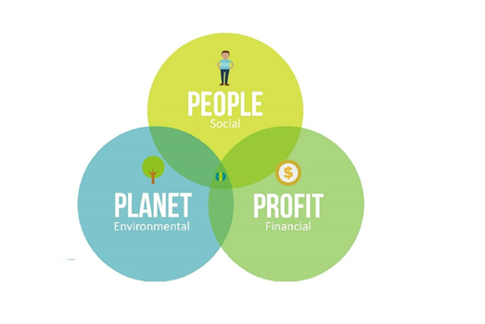
The Triple Bottom Line: People, Planet, AND Profit
In this view of corporate performance, an organization has a responsibility to its:
People,
Planet, and
Profit.

Slide 3

Internal & External Stakeholders
Managers operate in two organizational environments
Internal Stakeholders: Employees, Owners, Board of Directors
External Stakeholders: Task Environment and General Environment

Slide 4
THE COMMUNITY OF STAKEHOLDERS

Slide 5
The Task Environment
Customers
Competitors
Suppliers
Distributors
Strategic Allies
Employee Organizations
Local Communities
Financial Institutions
Government Regulators
Special-Interest Groups
Task environment consists of 10 groups that interact with the organization on a regular basis.

Slide 6
The General Environment
The general environment includes six forces:
Economic, Technological, Sociocultural, Demographic, Political – Legal, & International
You may be able to control some forces in the task environment, but you cannot control those in the general environment.

Slide 7
THE ETHICAL RESPONSIBILITIES REQUIRED OF YOU AS A MANAGER
Defining Ethics and Values
How Organizations Can Promote Ethics

Slide 8
Defining Ethics and Values
Ethical standards may vary among countries and among cultures.
Six most common workplace behaviors that are considered ethical misconduct.
Conflicts of interest
Abusive behaviors
Violations of health and safety regulations
Corruption
Discrimination
Sexual harassment

Slide 9

How Organizations Can Promote Ethics
Ethics needs to be an everyday, not one-time, thing:
Creating a strong ethical climate
Screening prospective employees
Instituting ethics codes and training programs
Rewarding ethical behavior: protecting whistle-blowers
Using a multi-faceted approach (i.e., all of the above)

Slide 10
THE SOCIAL RESPONSIBILITIES REQUIRED OF YOU AS A MANAGER
Corporate Social Responsibility: The Top of the Pyramid
Is Social Responsibility Worthwhile? Opposing and Supporting Viewpoints

Slide 11
Corporate Social Responsibility: The Top OF THE Pyramid.

Slide 12
Is Social Responsibility Worthwhile? Opposing AND Supporting Viewpoints
Against Social Responsibility:
Unless a company focuses on maximizing profits, it will become:
For Social Responsibility:
Beyond ethical obligation, the rationale for social responsibility is the belief that:
New slogan for today’s billionaires?:
Distracted
Fail to provide goods and services
Fail to benefit the stockholders
Fail to create jobs
Fail to expand economic growth
It is good for business
It is morally appropriate
It is important to employees
“Don’t die rich.”

